Slide 1


Practical Day01 Workshop Linking Climate data with Health
Alexia Sampri, Shivang Pandey
Population Health Impacts from Climate Extremes and Climatic Factors: 1st October, 14:00 Hrs

Slide 2
Learning Objectives
Population weighting: Adjusting environmental exposures based on where people actually live
Spatial intersection: Combining different spatial datasets to create new analytical units
Time series preparation: Creating complete datasets with daily observations for each individual

Slide 3
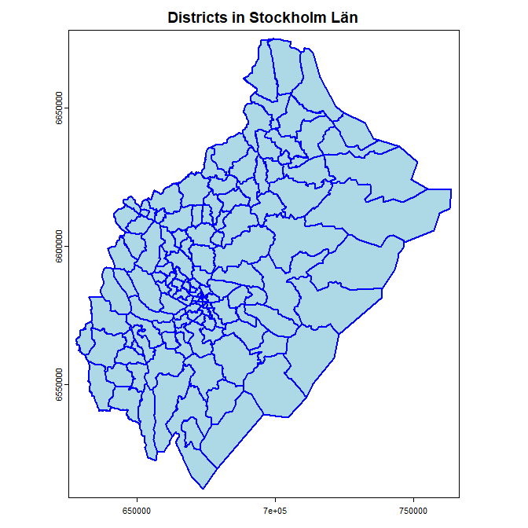
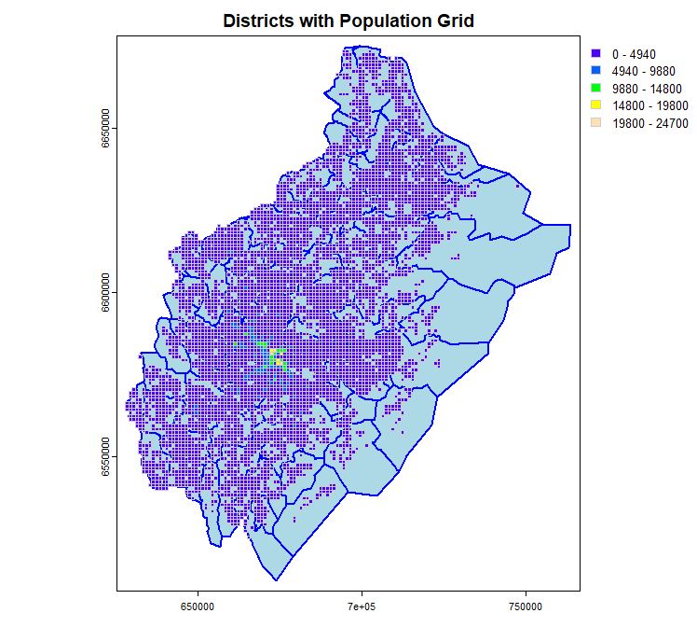
Districts and population

Slide 4
Part A: Spatial Data Preparation and Intersection
Spatial intersection creates new polygons where population grid cells overlap with administrative districts. This allows us to calculate how much of each population grid cell falls within each district.
The process involves:
Combine different spatial datasets
Calculate area-weighted contributions
Preserve spatial relationships in our data
Notes:
Spatial intersection creates new polygons where population grid cells overlap with administrative districts. This allows us to calculate how much of each population grid cell falls within each district.

Slide 5
Part B: Population-Weighted Temperature Calculation
Population weighting is crucial in environmental epidemiology because:
Environmental monitors don't always represent where people live
Administrative boundaries don't align with population distribution
We need to account for population density when calculating exposures
The process involves:
Extracting temperature values for each intersection polygon
Weighting by population density within each polygon
Aggregating to district level using population weights
Notes:
Spatial intersection creates new polygons where population grid cells overlap with administrative districts. This allows us to calculate how much of each population grid cell falls within each district.

Slide 6
Part C: Linking Climate Data with Health Data
Theoretical Background
Complete time series (no missing days)
Binary outcome indicators (event/no event)
Consistent exposure data for all individuals
Relevant confounding variables
Time series structure ensures we can:
Extracting temperature Model lag effects properly
Account for temporal correlation
Include sufficient baseline period
Notes:
Spatial intersection creates new polygons where population grid cells overlap with administrative districts. This allows us to calculate how much of each population grid cell falls within each district.

Slide 7
Data required
01_Workshop_Practical_Code.R – R code for exercise
01_Workshop_Practical_Details.Rmd – Details and solutions
totalbefolkning_stockholm_lan.gpkg - Population grid data
stockholm_lan_district.gpk - Administrative district boundaries
tas_NORDIC-3_SMHI-UERRA-Harmonie_RegRean_v1_Gridpp_v1.0.1_day_20180701-20180731.nc - Temperature data
health_events.csv - Health outcomes data
cohort_info.csv - Individual characteristics
tas_212098_daily.csv - Daily temperature series for 2018

